Slide 1
CAP 5320 FINAL PRESENTATION
PHYSICAL ACTIVITY IN ADULTS
BY: JOSHUA OLABISI

Slide 2



RECAP
Data focused on physical activity levels of adults in Florida
Data source: Center for Disease Control and Prevention (CDC)
Data cleaning

Slide 3
To what extent should physical activities (PA) be increased in order to reduce chronic diseases or hospitalization?
Low PA levels result in harmful and even detrimental consequences

Slide 4
SOME CONSEQUENCES OF PHYSICAL INACTIVITY
Some harmful consequences include:
High blood pressure
Obesity
Impaired circulation
Osteoporosis/Arthritis etc.…

Slide 5
DATA DESCRIPTION
The dataset is aggregated and a collection of observations
Aggregated means compiled in summaries of data or summary reports

Slide 6
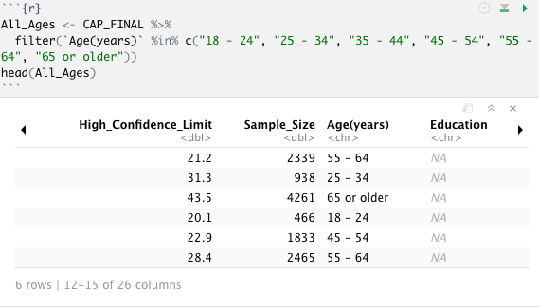
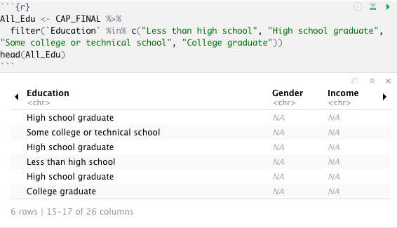
FILTERING AGGREGATED COLUMNS

Slide 7
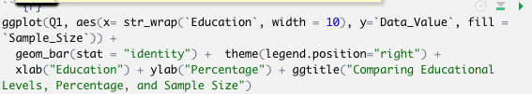
Comparing Question 1, Educational Levels, Percentage (Data Value), and Sample Size
Percent of adults who engage in muscle-strengthening activities on 2 or more days a week

Slide 8
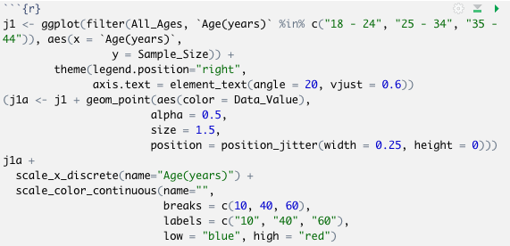
Focusing on Young Adults Age 18 - 44

Slide 9
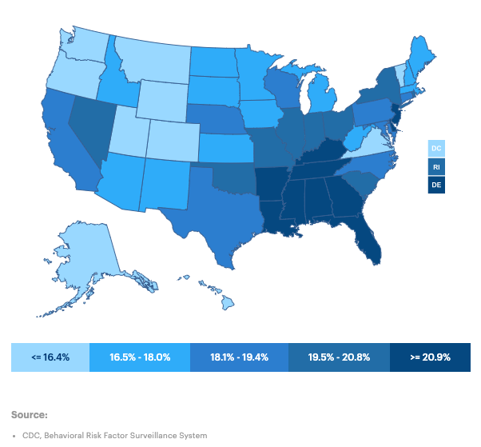
Percentage of the population ages 18-44 who reported doing no physical activity or exercise other than their regular job
Florida percentage: 22.3%

Slide 10
Conclusion
Based on the results of the analysis, it can be concluded that a higher percentage of young adults engage in little or no physical activity
In relation to the research question, it is imperative that the rate of physical activities is increased especially in young adults in order to prevent harmful consequences and hospitalization

